Slide 1
PSY325 Psychology of Expertise

Slide 2
What is an Expert?

Slide 3
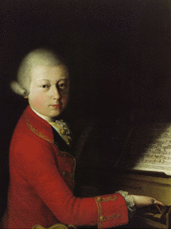
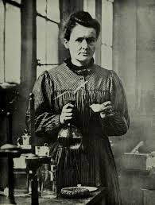
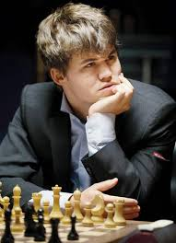
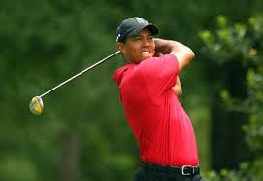
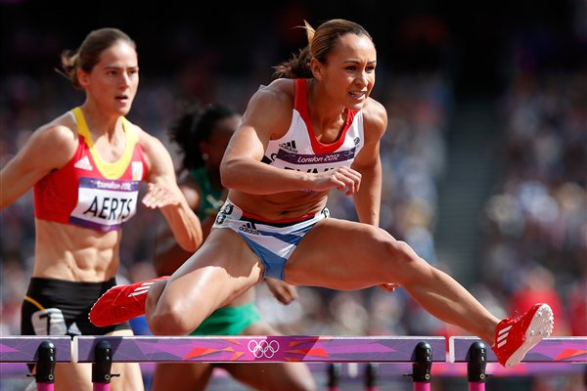

Slide 4
Module Convenor
Prof. Fernand Gobet
E-mail: fgobet@liv.ac.uk
Office hours:
Thursdays 1 pm – 5 pm
ERB 2.57
Current research
Psychology of expert behaviour
Computer modelling of expert behaviour
Computer modelling of the acquisition of language

Slide 5
Aims of Lectures
To provide an understanding of the psychological factors underpinning expert performance
To describe a wide range of research methods used to study expertise
To provide an understanding of the role of experts in society

Slide 6
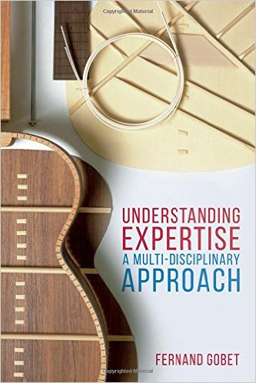
Readings
Textbook
Gobet, F. (2015) Understanding expertise. London: Palgrave.
VITAL
PPT presentations
Books in the library
http://readinglists.liverpool.ac.uk/lists/EFF9082D-8D33-5C2C-0B13-2BA9B6D057A3.html

Slide 7
Articles
http://chrest.info/PY3602-Psychology-of-Expertise/PY3602-Psychology-of-Expertise.html
Library: DISCOVER...

Slide 8
Content of Lectures
Introduction
Perception and memory
Problem solving and decision making
Learning and education: practice vs. talent
Development and aging

Slide 9
Creativity
Personality and intelligence
Gender differences
The neuroscience of expertise
Broader aspects: sociology, philosophy and artificial intelligence
Exam preparation

Slide 10
Evaluation
Coursework essay
Weighting: 25%
1 question from a choice of 6 questions
Unseen written exam (two hours)
Weighting: 75%
2 questions from a choice of 6 questions

Slide 11
Definitions of Expertise

Slide 12
The Dual Meaning of “Expertise”
Definition of the Oxford Talking Dictionary (1998):
Expert opinion or knowledge; know-how, skill, or expertness in something
Two essentials aspects:
knowledge or even opinion – knowing that
skill – knowing how

Slide 13
Expertise as Experience
Amount of time an individual has spent in a domain
A weak definition
Experience does not correlate much with expertise
e.g., amateur tennis players
Deliberate practice offers a better measure
Ericsson et al. (1993)

Slide 14
Expertise Defined by Diplomas
e.g. use of PhDs, professional certificates
Common definition
Diplomas have weaknesses
Based on socio-cultural criteria
Often do not test “real-life” skills, but declarative knowledge
e.g. medecine, psychology
Provide little detail about level and nature of expertise

Slide 15
Ecological Measures (I)
Measures that are part of the culture of the domain
Business – amount of wealth
Science – number of citations
Writing – number of books sold
Socio-cultural biases are possible
e.g. fashion, random factors

Slide 16
Ecological Measures (II)
Ideal: objective quantitative measure of expert performance within a domain
Time to run 100 m
This is rare outside sports
Rank-ordering systems
Belt system in karate
FIFA’s ranking of national football teams
ATP ranking in tennis
These systems have limitations

Slide 17
Ecological Measures (III)
Elo rating
Elo (1965)
Mostly used in chess, but also in table tennis
Takes into account
outcome of a game (win, loss or draw)
skill level of the opponent
Updated after every competitive game
Provides a precise and up-to-date measure of expertise
Explains why much research has been done on chess

Slide 18
Expertise as Replicable Performance in the Laboratory
Ericsson and Smith (1991)
Chess masters must find good moves in chess problems
Medical doctors should find the correct diagnosis
A reasonable requirement, at least in some domains
But there are exceptions:
Developing a new ground-breaking theory in physics
Creating a new style in art

Slide 19
Expertise is Acquired…
… with effort and intentionally
Bereiter and Scardamalia (1993)
… without effort and implicitly, through talent
Eysenck (1995)
Arguably, the way expertise is acquired is not relevant to its definition

Slide 20
Expertise as Fluid Behaviour
Behaviour is automatic and requires little conscious control
Valid with many types of expertise, but not all
The opposite definition has also been proposed:
“The expert addresses problems whereas the experienced nonexpert carries out practiced routines” (Bereiter & Scardamalia, 1993)
Routine actions hinder the development of expertise (Ericsson et al., 1993)

Slide 21
Expertise as Social Label
Label given by
Society
Group of people
Sometimes irrespectively of real competences
“Expertise” can only be used within a specific context
Stein (1997)
Expertise resides both in the expert and a social system

Slide 22
The Definition Used in this Class
An expert is somebody who obtains results that are vastly superior to those obtained by the majority of the population
Can be applied recursively
A “super-expert” is somebody whose performance is vastly superior to the majority of experts
Can be applied to “common” domains of expertise
language, walking, breathing
Can be used with know how and know that

Slide 23
Why Study Expertise?

Slide 24
Studying Expertise… (I)
Sheds important light on learning
This can lead to better methods of instruction and training in general
Can lead to better ways of coaching experts
Better methods can have stunning effects
e.g. Swimmer Mark Spitz wouldn’t qualify for semi-finals now

Slide 25
Studying Expertise… (II)
Can inform the development of artificial expert systems
Offers a unique window on human cognition
Research on expertise has identified several general cognitive mechanisms
role of pattern recognition in decision making
progressive deepening
selective search
Mirror image to neuropsychology
Impaired performance vs. amazing performance

Slide 26
Studying Expertise… (III)
Emphasises the positive aspects of human psychology
Contrary to most psychology, which focuses on negative aspects of human psychology (e.g. pathology)
Has anticipated at least some of the claims of positive psychology
Seligman and Csikszentmihalyi (2000)
Focuses on hope, optimism, strengths and virtues

